Slide 1
Covariance and Correlation Models
Elements of
Financial Risk Management
Chapter 7
Peter Christoffersen
Elements of Financial Risk Management Second Edition © 2012 by Peter Christoffersen

Slide 2
Overview
This Chapter models dynamic covariance and correlation, which along with dynamic volatility models is used to construct covariance matrices.
Chapter 8 will describe simulation tools such as Monte Carlo and bootstrapping, which are needed for multiperiod risk assessments.
Chapter 9 will introduce copula models used to link together the nonnormal univariate distributions.
Correlation models only allow for linear dependence between asset returns whereas copula models allow for nonlinear dependence.
Elements of Financial Risk Management Second Edition © 2012 by Peter Christoffersen

Slide 3
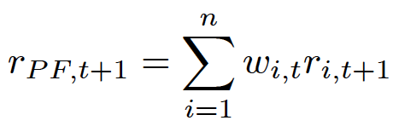
Portfolio Variance and Covariance
Consider a portfolio of n securities
The return on the portfolio on date t+1 is
The sum is taken over the n securities in portfolio
w_{i,t} denotes the relative weight of security i at the end of day t.
Elements of Financial Risk Management Second Edition © 2012 by Peter Christoffersen

Slide 4
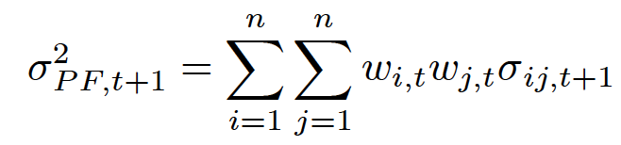
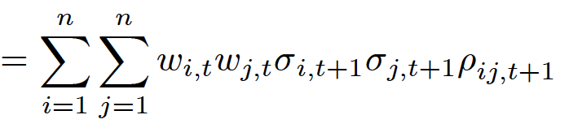
Portfolio Variance and Covariance
The variance of the portfolio is
Where σ_{ij,t+1} and ρ_{ij,t+1} are covariance and correlation respectively between security i and j on day t+1
Note σ_{ij,t+1} = σ_{ji,t+1} and ρ_{ij,t+1} = ρ_{ji,t+1} for all i and j
Also we have ρ_{ii,t+1} =1 and σ_{ii,t+1} =σ²_{i,t+1} for all i
Elements of Financial Risk Management Second Edition © 2012 by Peter Christoffersen

Slide 5

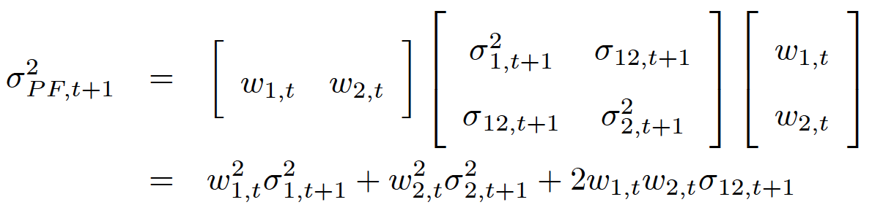
Portfolio Variance and Covariance
Using vector notation we can write:
where w_{t} is the n by 1 vector of portfolio weights and Σ_{t+1} is the n by n covariance matrix of returns
In the case where n = 2 we have
Elements of Financial Risk Management Second Edition © 2012 by Peter Christoffersen

Slide 6

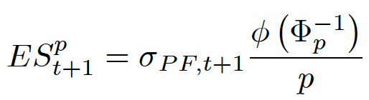
Portfolio Variance and Covariance
If we assume assets are multivariate normally distributed, then the portfolio is normally distributed and we can write,
Note: if we have n assets in the portfolio then we have to model n(n-1)/2 different correlations
So if n is 100, then we’ll have 4950 correlations to model, a daunting task that forces us to find methods that can easily handle large-dimensional portfolios
Elements of Financial Risk Management Second Edition © 2012 by Peter Christoffersen

Slide 7

Exposure Mapping
One way to reduce dimensionality of portfolio variance is to impose a factor structure using observed market returns as factors.
In the extreme case we assume that portfolio return is the market return plus a portfolio specific risk term:
where we assume that the idiosyncratic risk term, ε_{t+1}, is independent of the market return and has constant variance.
The portfolio variance in this case is
Elements of Financial Risk Management Second Edition © 2012 by Peter Christoffersen

Slide 8


Exposure Mapping
In a well diversified stock portfolio, for example, we can assume that the variance of the portfolio equals that of the S&P 500 market index.
In this case, only one volatility needs to be modelled, and no correlation modelling is necessary.
This is referred to as index mapping and written as:
The 1-day VaR assuming normality is
Elements of Financial Risk Management Second Edition © 2012 by Peter Christoffersen

Slide 9



Exposure Mapping
In general, portfolios that contain systematic risk have
So that
If the portfolio is well diversified then the portfolio-specific risk can be ignored, and we can pose a linear relationship between the portfolio and the market index and use the beta mapping as
Here only an estimate of β is necessary and no further correlation modelling is needed.
Elements of Financial Risk Management Second Edition © 2012 by Peter Christoffersen

Slide 10
Exposure Mapping
The risk manager of a large-scale portfolio may consider risk coming from a reasonable number of factors n_{F} where n_{F} << n so that we have many fewer risk factors than assets
Let us assume that we need 10 factors.
We can write the 10-factor return model as
here ε_{t+1} is assumed to be independent of risk factors
In this case, it makes sense to model the variances and correlations of these risk factors and assign exposures to each factor to get the portfolio variance.
Elements of Financial Risk Management Second Edition © 2012 by Peter Christoffersen

Slide 11


Exposure Mapping
The portfolio variance in this general factor structure can be written
where β_{F} is a vector of exposures to each risk factor and where Σ^{F}_{t+1} is the covariance matrix of the returns from the risk factors.
Again, if the factor model explains a large part of the portfolio return variation, then we can assume that
Elements of Financial Risk Management Second Edition © 2012 by Peter Christoffersen

Slide 12
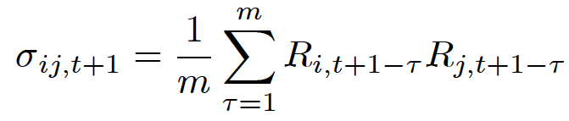
GARCH Conditional Covariance
Suppose a portfolio contains n assets or factors. An n-dimensional covariance matrix must be estimated where n may be a large number.
Now, we turn to various methods for constructing the covariance matrix directly, without first modeling the correlations.
The simplest way to model time varying covariances is to rely on plain rolling averages.
For the covariance between assets i and j, we can simply estimate
Elements of Financial Risk Management Second Edition © 2012 by Peter Christoffersen

Slide 13
GARCH Conditional Covariance
where m is the number of days used in the moving estimation window
This estimate is very easy to construct but it is not satisfactory due to dependence on choice of m and equal weighting put on past cross products of returns
We assume that the average expected return on each asset is zero
Elements of Financial Risk Management Second Edition © 2012 by Peter Christoffersen

Slide 14
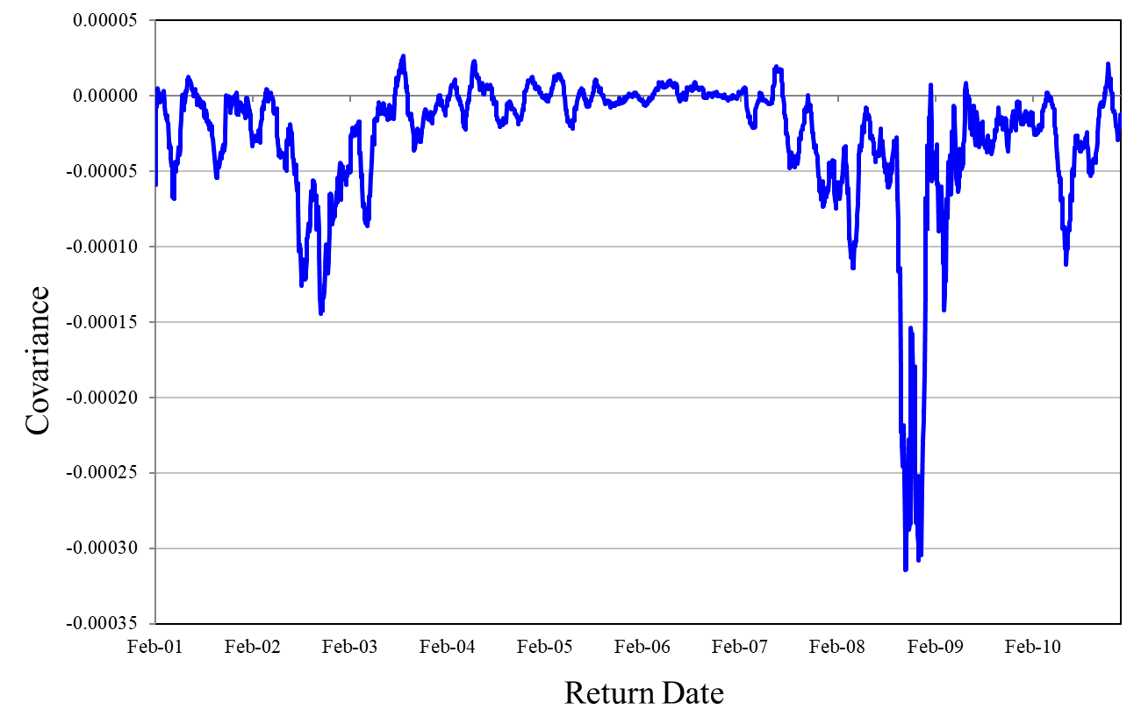
Figure 7.1: Rolling Covariance between S&P 500 and 10-Year Treasury Note Index
Elements of Financial Risk Management Second Edition © 2012 by Peter Christoffersen

Slide 15

GARCH Conditional Covariance
To avoid equal weighting we can use a simple exponential smoother model on the covariances, and let
where λ=0.94 as it was for the corresponding volatility model in the previous chapters
Elements of Financial Risk Management Second Edition © 2012 by Peter Christoffersen

Slide 16
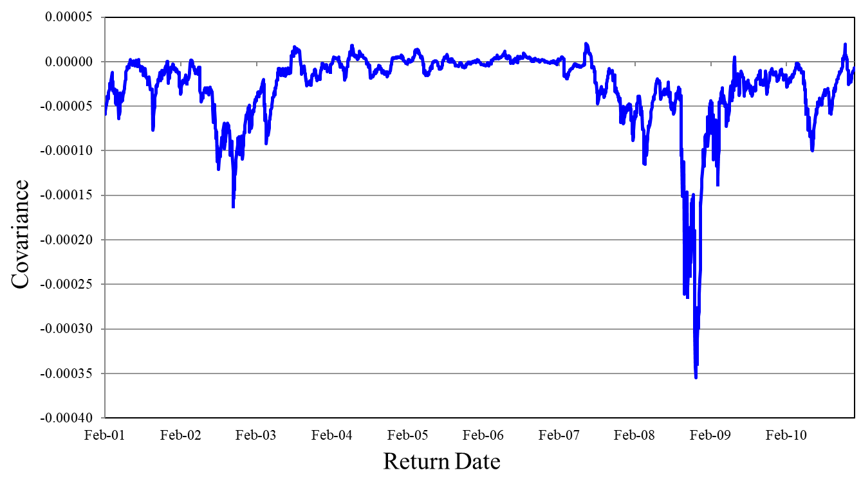
Figure 7.2: Exponentially Smoothed Covariance between S&P 500 and 10-year Treasury Note Index
Elements of Financial Risk Management Second Edition © 2012 by Peter Christoffersen

Slide 17

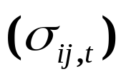
GARCH Conditional Covariance
The caveats which applied to the exponential smoother volatility model, apply to the exponential smoother covariance model as well
The restriction that the coefficient (1-λ) on the cross product of returns and coefficient λ on the past covariance sum to one is not desirable.
The restriction implies that there is no mean-reversion in covariance
If tomorrow’s forecasted covariance is high then it will remain high for all future horizons, rather than revert back to its mean.
Elements of Financial Risk Management Second Edition © 2012 by Peter Christoffersen

Slide 18

GARCH Conditional Covariance
We can instead consider models with mean-reversion in covariance.
For example, a GARCH-style specification for covariance would be
which will tend to revert to its long-run average covariance, which equals
Elements of Financial Risk Management Second Edition © 2012 by Peter Christoffersen

Slide 19

GARCH Conditional Covariance
Note that we have not allowed for the persistence parameters λ, α and β to vary across pairs of securities in the covariance models
This is done to guarantee that the portfolio variance will be positive regardless of the portfolio weights, w_{t}.
A covariance matrix Σ_{t+1} is internally consistent if for all possible vectors w_{t} of portfolio weights we have
Thus covariance matrix is positive semidefinite. It is ensured by estimating volatilities and covariances in an internally consistent fashion.
Elements of Financial Risk Management Second Edition © 2012 by Peter Christoffersen

Slide 20
GARCH Conditional Covariance
For example, relying on exponential smoothing using the same λ for every volatility and every covariance will work.
Similarly, using a GARCH(1,1) model with α and β identical across variances and covariances will work as well.
Unfortunately, it is not clear that the persistence parameters λ, α and β should be the same for all variances and covariance
We therefore next consider methods that are not subject to this restriction
Elements of Financial Risk Management Second Edition © 2012 by Peter Christoffersen

Slide 21

Dynamic Conditional Correlation
Now we will model correlation rather than covariance
Variances and covariance are restricted by the same persistence parameters
Covariance is a confluence of correlation and variance. Could be time varying just from variances.
Correlations increase during financial turmoil and thereby increase risk even further
Therefore, modeling correlation dynamics is crucial to a risk manager
Correlation is defined from covariance and volatility by
Elements of Financial Risk Management Second Edition © 2012 by Peter Christoffersen

Slide 22
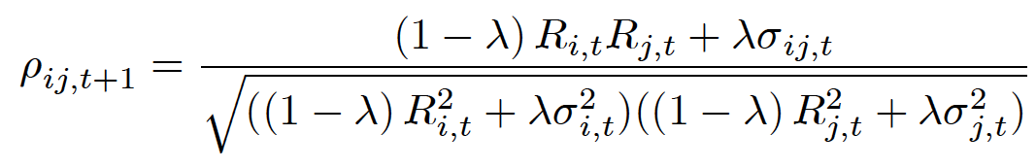
Dynamic Conditional Correlation
If we have the RiskMetrics model, then
and then we get the implied dynamic correlations
which isn’t particularly intuitive, we therefore consider models where dynamic correlation is modeled directly
The definition of correlation can be rearranged to provide the decomposition of covariance into volatility and correlation
Elements of Financial Risk Management Second Edition © 2012 by Peter Christoffersen

Slide 23

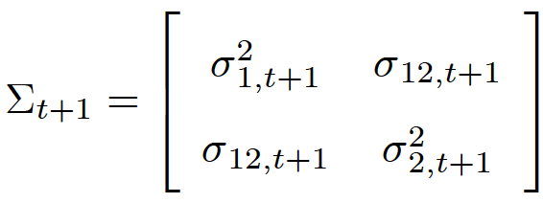
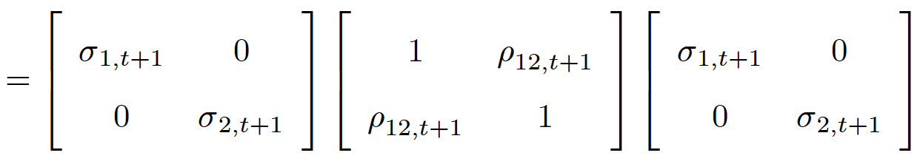
Dynamic Conditional Correlation
In matrix notation, we can write
where D_{t+1} is a matrix of standard deviations, σ_{i,t+1}, on the ith diagonal and zero everywhere else, and where ϒ_{t+1} is a matrix of correlations, ρ_{ij,t+1}, with ones on the diagonal.
In the two-asset case, we have
Elements of Financial Risk Management Second Edition © 2012 by Peter Christoffersen

Slide 24

Dynamic Conditional Correlation
We will consider the volatilities of each asset to already have been estimated through GARCH or one of the other methods considered in Chapter 4 or 5
We can then standardize each return by its dynamic standard deviation to get the standardized returns,
By dividing the returns by their conditional standard deviation, we create variables, z_{i,t+1}, i = 1,2,…,n, which all have a conditional standard deviation of one
Elements of Financial Risk Management Second Edition © 2012 by Peter Christoffersen

Slide 25
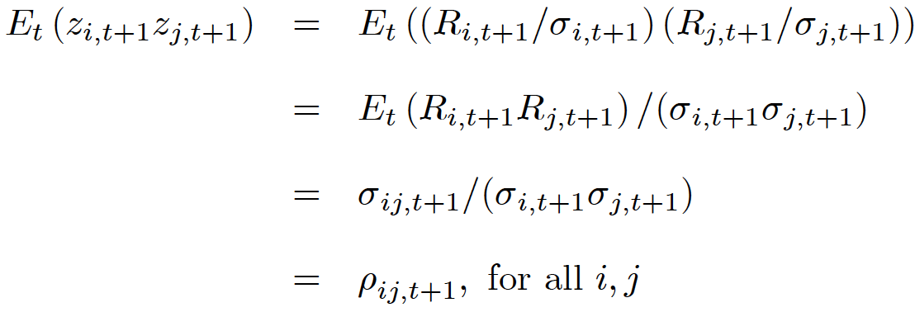
Dynamic Conditional Correlation
The conditional covariance of the z_{i,t+1} variables equals the conditional correlation of the raw returns as can be seen from
Thus, modeling the conditional correlation of the raw returns is equivalent to modeling the conditional covariance of the standardized returns
Elements of Financial Risk Management Second Edition © 2012 by Peter Christoffersen

Slide 26
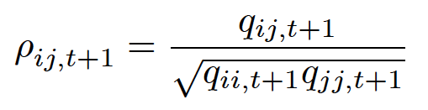
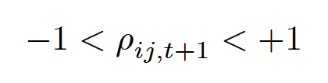
Exponential Smoother correlations
First we consider simple exponential smoothing correlation models.
Let the correlation dynamics be driven by q_{ij,t+1}, which gets updated by the cross product of the standardized returns z_{i,t} and z_{j,t} as in
The conditional correlation can now be obtained by normalizing the q_{ij,t+1} variable as in
Now we need to do the normalization to ensure that
on each day.
Elements of Financial Risk Management Second Edition © 2012 by Peter Christoffersen

Slide 27
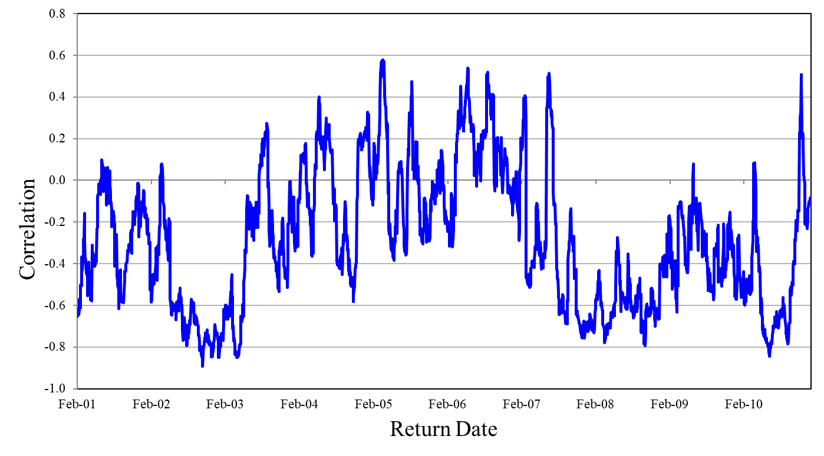
Figure 7.3: Exponentially Smoothed Correlation between S&P 500 and 10-year Treasury Note Index
Elements of Financial Risk Management Second Edition © 2012 by Peter Christoffersen

Slide 28
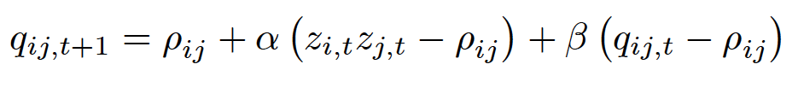

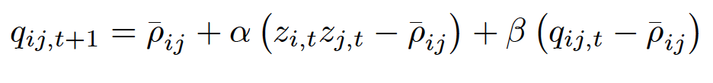
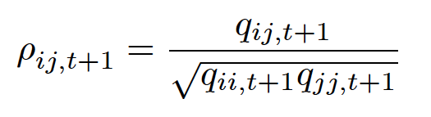
Mean-Reverting Correlation
Consider a generalization of exponential smoothing correlation model, which allows for correlations to revert to a long-run average correlation ρ_{ij} = E [z_{i,t}z_{j,t}]
GARCH(1,1) type specification:
If we rely on correlation targeting, and set
, then we have
Again we have to normalize to get the conditional correlations
Elements of Financial Risk Management Second Edition © 2012 by Peter Christoffersen

Slide 29
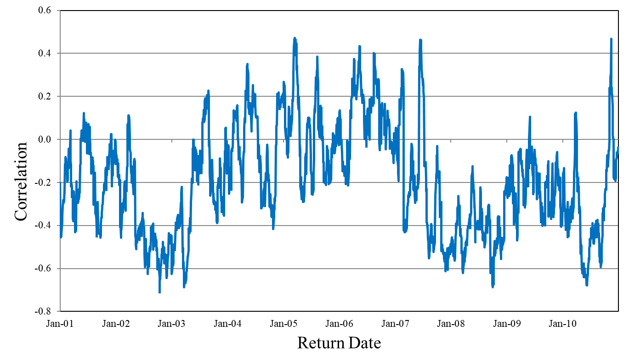
Figure 7.4: Mean-Reverting Correlation between S&P 500 and 10-Year Treasury Note
Elements of Financial Risk Management Second Edition © 2012 by Peter Christoffersen

Slide 30
Mean-Reverting Correlation
Note that correlation persistence parameters α and β are common across i and j.
It does not imply that the level of correlations at any time are the same across pairs of assets.
It does not imply that the persistence in correlation is the same persistence in volatility.
The model does imply that the persistence in correlation is constant across assets
Fig 7.4 shows the GARCH(1,1) correlations for the S&P500 and 10-year treasury note example.
Elements of Financial Risk Management Second Edition © 2012 by Peter Christoffersen

Slide 31

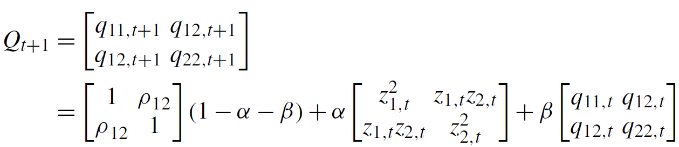
Mean-Reverting Correlation
We write the models in matrix notation as
For the exponential smoother, and for the mean-reverting DCC, we can write
In two-asset case for mean-reverting model, we have
Elements of Financial Risk Management Second Edition © 2012 by Peter Christoffersen

Slide 32
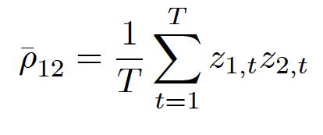
Mean-Reverting Correlation
where ρ₁₂ is the unconditional correlation between the two assets, which can be estimated as
An important feature of these models is that the matrix Q_{t+1} is positive semi-definite as it is a weighted average of positive semi-definite and positive definite matrices.
This will ensure that the correlation matrix ϒ_{t+1} and the covariance matrix Σ_{t+1} will be positive semi-definite as required.
Elements of Financial Risk Management Second Edition © 2012 by Peter Christoffersen

Slide 33
Mean-Reverting Correlation
A key advantage of this model is that we can estimate the parameters in a sequential fashion.
First all the individual variances are estimated one by one using one of the methods from Chapter 4 or 5
Second, the returns are standardized and the unconditional correlation matrix is estimated.
Third, the correlation persistence parameters α and β are estimated.
The key issue is that only very few parameters are estimated simultaneously using numerical optimization. This makes the dynamic correlation models considered extremely tractable for risk management of large portfolios.
Elements of Financial Risk Management Second Edition © 2012 by Peter Christoffersen

Slide 34
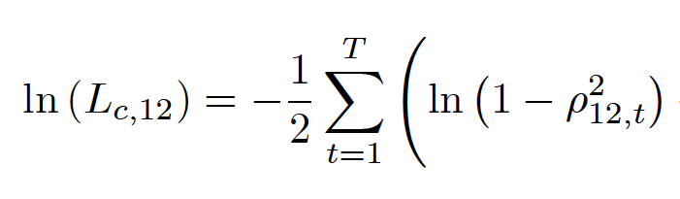
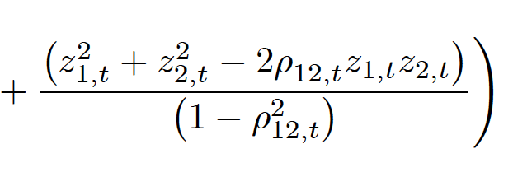
Bivariate Quasi-Maximum Likelihood Estimation
We begin by analyzing a portfolio consisting of only two assets
In this case, we can use the bivariate normal distribution function for z_{1,t} and z_{2,t} to write the log likelihood as
Elements of Financial Risk Management Second Edition © 2012 by Peter Christoffersen

Slide 35
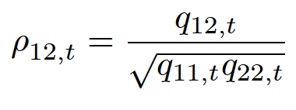
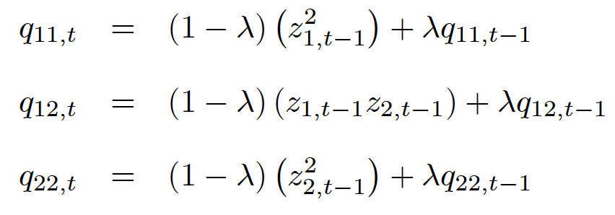
Bivariate Quasi-Maximum Likelihood Estimation
Where ρ_{12,t} is given from the particular correlation model being estimated, and the normalization rule
In the simple exponential smoother example
where
Elements of Financial Risk Management Second Edition © 2012 by Peter Christoffersen

Slide 36
Bivariate Quasi-Maximum Likelihood Estimation
We find the optimal correlation parameter(s), in this case λ, by maximizing the correlation log-likelihood function, ln(L_{c,12})
To initialize the dynamics, we set
Notice that the variables that enter the likelihood are the standardized returns, z_{t}, and not the original raw returns, R_{t} themselves.
We are essentially treating the standardized returns as actual observations here.
Elements of Financial Risk Management Second Edition © 2012 by Peter Christoffersen

Slide 37
Bivariate Quasi-Maximum Likelihood Estimation
To get efficient estimates, we are forced to rely on a stepwise QMLE method where we first estimate the volatility model for each of the assets and second estimate the correlation models
This approach gives decent parameter estimates while avoiding numerical optimization in high dimensions.
Elements of Financial Risk Management Second Edition © 2012 by Peter Christoffersen

Slide 38
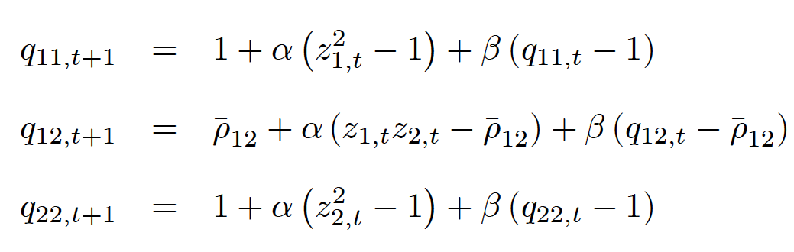

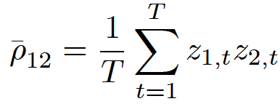
Bivariate Quasi-Maximum Likelihood Estimation
In the case of the mean-reverting GARCH correlations we have the same likelihood function and correlation definition but now
Where can be estimated using
Elements of Financial Risk Management Second Edition © 2012 by Peter Christoffersen

Slide 39

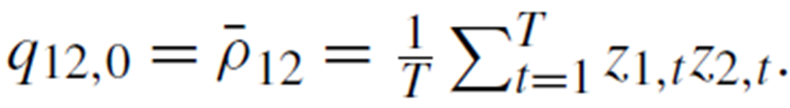
Bivariate Quasi-Maximum Likelihood Estimation
Therefore we only have to find α and β using numerical optimization
Again, in order to initialize the dynamics, we set
and
Elements of Financial Risk Management Second Edition © 2012 by Peter Christoffersen

Slide 40
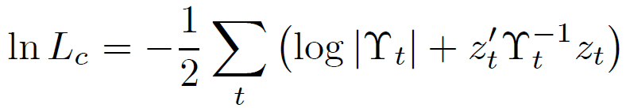
Composite Likelihood Estimation in Large Systems
In a portfolio with n assets, we rely on n-dimensional normal distribution function to write log likelihood as
where |ϒ_{t}| denotes the determinant of the correlation matrix, ϒ_{t}
Maximizing this likelihood can be very cumbersome if n is large
The correlation matrix ϒ_{t} must be inverted on each day and for many possible values of the parameters in the model when doing the numerical search for optimal parameter values
Elements of Financial Risk Management Second Edition © 2012 by Peter Christoffersen

Slide 41
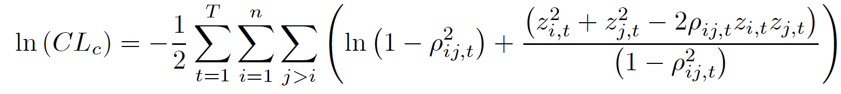
Composite Likelihood Estimation in Large Systems
When n is large the inversion of ϒ_{t} will be slow and inaccurate causing biases in parameter values
To solve dimensionality problem, we can maximize the sum of the bivariate likelihoods rather than maximizing the n-dimensional log likelihood
Computationally this composite likelihood function is much easier to maximize than the likelihood function where the n-dimensional correlation matrix must be inverted numerically
Elements of Financial Risk Management Second Edition © 2012 by Peter Christoffersen

Slide 42
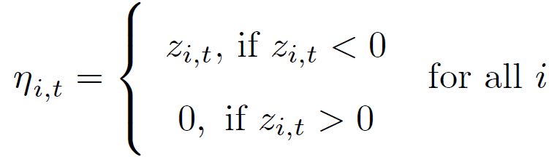
An Asymmetric Correlation Model
Now we model for a down-market effect in correlation
This can be achieved using the asymmetric DCC model where
where the n_{i,t} for asset i is defined as the negative part of z_{i,t} as follows
Elements of Financial Risk Management Second Edition © 2012 by Peter Christoffersen

Slide 43
An Asymmetric Correlation Model
Note that γ corresponds to a leverage effect in correlation: When γ is positive then the correlation for asset i and j will increase more when z_{i,t} and z_{j,t} are negative than in any other case.
If we envision a scatterplot of z_{i,t} and z_{j,t}, then γ > 0 will provide an extra increase in correlation when we observe an observation in the lower left quadrant of the scatterplot.
This captures a phenomenon often observed in markets for risky assets: Their correlation increases more in down markets (z_{i,t} and z_{j,t} both negative) than in up markets (z_{i,t} and z_{j,t} both positive).
Elements of Financial Risk Management Second Edition © 2012 by Peter Christoffersen

Slide 44
Estimating Daily Covariance from Intraday Data
The main concern when computing realized covariance is the asynchronicity of intraday prices across assets.
Asynchronicity of intraday prices will cause a bias toward zero of realized covariance unless we estimate it carefully.
Because asset covariances are typically positive a bias toward zero means we will be underestimating covariance and thus underestimating portfolio risk.
This is clearly not a mistake we want to make.
Elements of Financial Risk Management Second Edition © 2012 by Peter Christoffersen

Slide 45
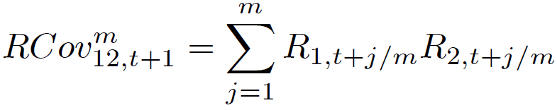
Realized Covariance
Consider first daily covariance estimation using, say, 1-minute returns
Let the jth observation on day t+1 for asset 1 be denoted S_{1,t+j/m}
Then the jth return on day t+1 is
Observing m returns within a day for two assets recorded at exactly the same time intervals, we can in principle calculate an estimate of the realized daily covariance from the intraday cross product of returns as
Elements of Financial Risk Management Second Edition © 2012 by Peter Christoffersen

Slide 46
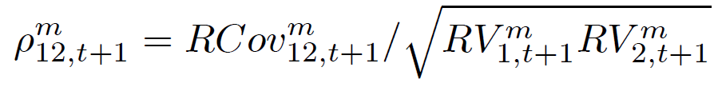
Realized Covariance
Given estimates of the two volatilities, the realized correlation can be calculated as
where RV^{m}_{1,t+1} is the All RV estimator computed for asset 1
Using the All RV estimate based on all m intraday returns is not a good idea because of the biases arising from illiquidity at high frequencies
We can instead rely on the Average (Avr) RV estimator, which averages across a number of sparse (using lower-frequency returns) RVs
Elements of Financial Risk Management Second Edition © 2012 by Peter Christoffersen

Slide 47
Realized Covariance
Using the averaging idea for the RCov as well we would then have
RCov^{Avr} can be computed as the average of, say, 15 sparse Rcov^{s}_{12,t+1} estimators computed on overlapping 15-minute grids
Going from All RV to Average RV will fix the bias problems in the RV estimates but it will unfortunately not fix the bias in the RCov estimates: Asynchronicity will still cause a bias toward zero in RCov
Elements of Financial Risk Management Second Edition © 2012 by Peter Christoffersen

Slide 48
Realized Covariance
The current best practice for alleviating the asynchronicity bias in daily RCov relies on changing the time scale of the intraday observations.
When we observe intraday prices on n assets the prices all arrive randomly throughout the day and randomly across assets.
The trick for dealing with asynchronous data is to synchronize them using so-called refresh times
Elements of Financial Risk Management Second Edition © 2012 by Peter Christoffersen

Slide 49
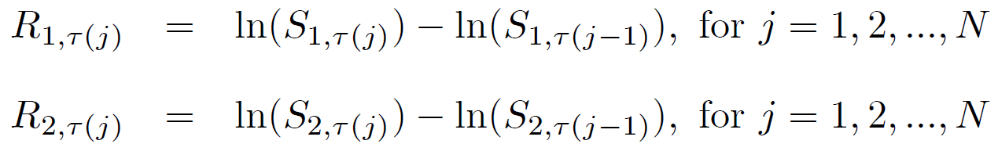
Realized Covariance
Let τ(1) be the first time point on day t+1 when all assets have changed their price at least once since market open.
Let τ(2) be the first time point on day t+1 when all assets have changed their price at least once since τ(1), and so on for τ(j), j = 1,2,..,N.
The synchronized intraday returns for the n assets can now be computed using the τ(j) time points.
For assets 1 and 2 we have
Elements of Financial Risk Management Second Edition © 2012 by Peter Christoffersen

Slide 50
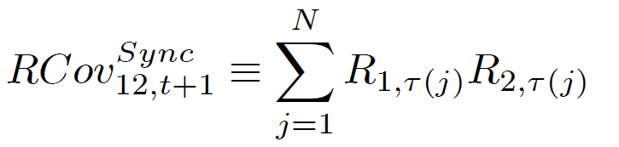
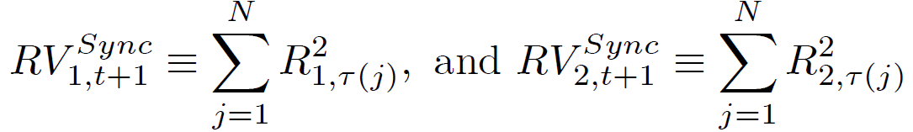
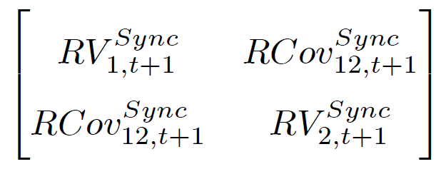
Realized Covariance
so that we can define the synchronized realized covariance between them as
If realized variances are computed from the same refresh grid of prices
then the variance-covariance matrix
will be positive definite
Elements of Financial Risk Management Second Edition © 2012 by Peter Christoffersen

Slide 51
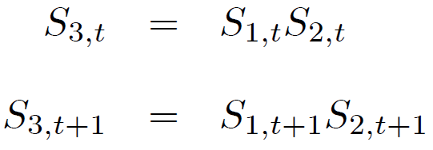
Range Based Covariance using
No-Arbitrage Conditions
While it is straightforward to generalize the idea of realized volatility to realized correlation, extending range-based volatility to range-based correlation is less obvious as the cross product of the ranges is not meaningful
But consider the case where S₁ is the US$/Yen FX rate, and S₂ is the Euro/US$ FX rate. If we define S₃ to be the Euro/Yen FX rate, then by ruling out arbitrage opportunities we write
Elements of Financial Risk Management Second Edition © 2012 by Peter Christoffersen

Slide 52


Range Based Covariance using No-Arbitrage Conditions
Therefore the log returns can be written
and the variances as
Thus, we can rearrange to get the covariance between US$/yen and Euro/US$ from
If we then use one of the range-based proxies from Chapter 5, for example
Elements of Financial Risk Management Second Edition © 2012 by Peter Christoffersen

Slide 53
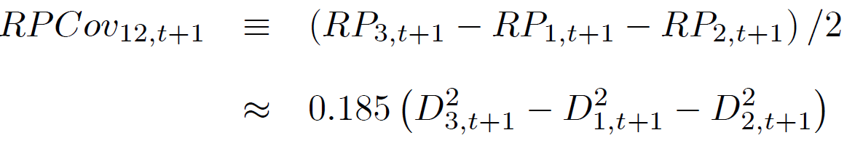
Range Based Covariance using No-Arbitrage Conditions
we can define the range-based covariance proxy
Similar arbitrage arguments can be made between spot and futures prices and between portfolios and individual assets assuming of course that the range prices can be found on all the involved series
Elements of Financial Risk Management Second Edition © 2012 by Peter Christoffersen

Slide 54
Range Based Covariance using No-Arbitrage Conditions
Range-based proxies for covariance can be used as regressors in GARCH covariance models.
Consider, for example,
Including the range-based covariance estimate in a GARCH model instead of using it by itself will have the beneficial effect of smoothing out some of the inherent noise in range-based estimate of covariance
Elements of Financial Risk Management Second Edition © 2012 by Peter Christoffersen

Slide 55
Summary
For normally distributed returns, the covariance matrix is all that is needed to calculate the VaR
First, we presented simple rolling estimates of covariance, followed by simple exponential smoothing and GARCH models of covariance
We then discussed the important issue of estimating variances and covariances
We then presented a simple framework for dynamic correlation modelling
Finally, we presented methods for daily covariance and correlation estimation using intraday data.
Elements of Financial Risk Management Second Edition © 2012 by Peter Christoffersen

